Slide 1
MA3077 (DLI) Operational Research Lecture 20 – Finite queues
Dr Marco Fasondini

Slide 2
Recapitulation and lecture outline
Recap: so far we have learnt the basics of queueing theory, Little's law, and how to analyse the M/M/s model with infinitely long queues as a birth-and-death process.
In this lecture: The M/M/s with finite queue, aka the M/M/s/K model (following Ch. 17.6 of the book by Hillier and Lieberman). The key difference of this model is that if the queueing system is full, then no further customer is allowed to enter the queueing system.

Slide 3
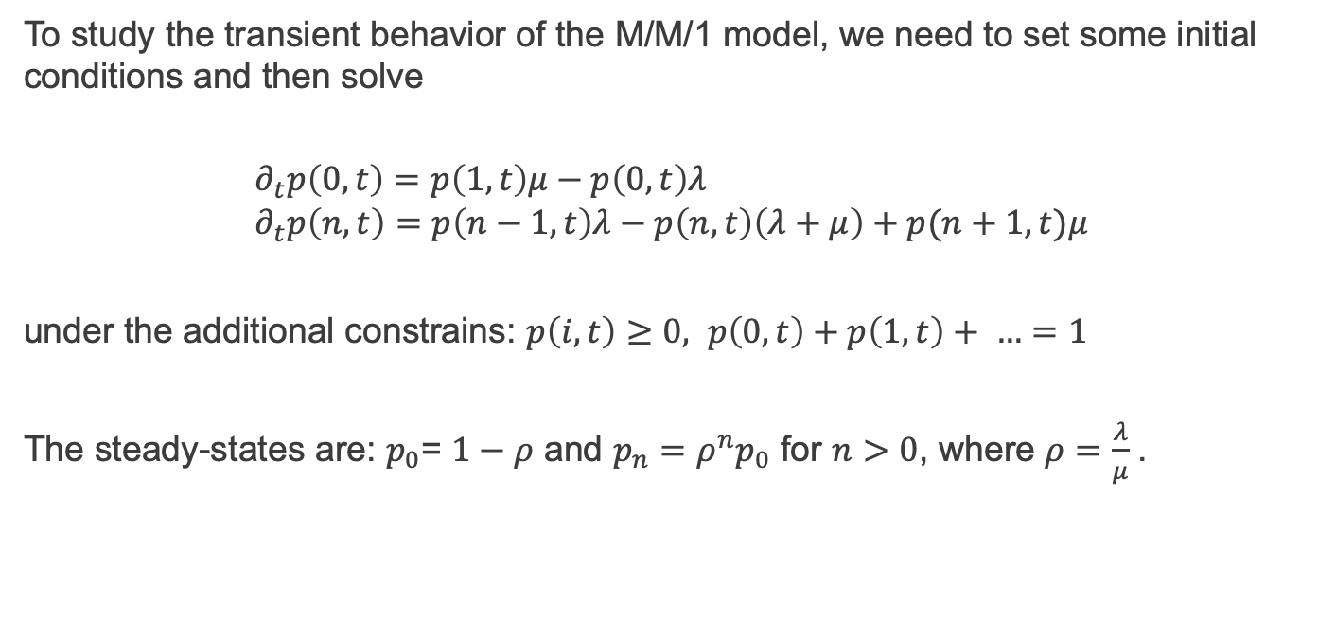
The M/M/1 model – transient behavior
To study the transient behavior of the M/M/1 model, we need to set some initial conditions and then solve
$$∂_{t}p\left(0,t\right)=p\left(1,t\right)μ−p\left(0,t\right)λ \\ ∂_{t}p\left(n,t\right)=p\left(n−1,t\right)λ−p\left(n,t\right)\left(λ+μ\right)+p(n+1,t)μ$$
under the additional constrains: $p\left(i,t\right)≥0, p\left(0,t\right)+p\left(1,t\right)+ …=1$
The steady-states are: $p_{0}\text{= }1−ρ$ and $p_{n}=ρ^{n}p_{0}$ for $n>0$, where $ρ=$ $\frac{λ}{μ}$.

Slide 4
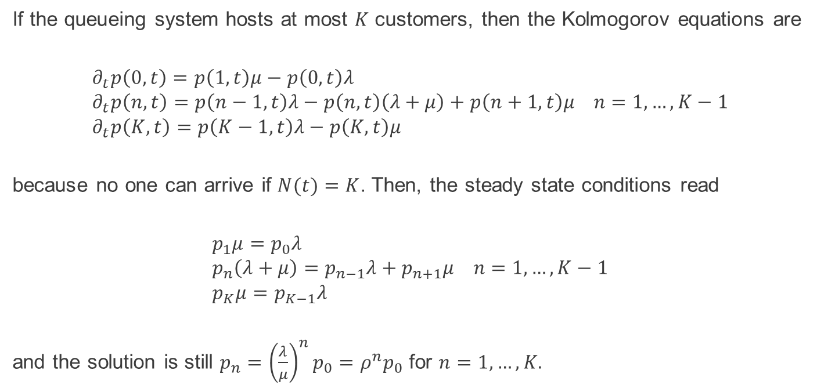
The M/M/1/K model
If the queueing system hosts at most $K$ customers, then the Kolmogorov equations are
$$∂_{t}p\left(0,t\right)=p\left(1,t\right)μ−p\left(0,t\right)λ \\ ∂_{t}p\left(n,t\right)=p\left(n−1,t\right)λ−p\left(n,t\right)\left(λ+μ\right)+p\left(n+1,t\right)μ n=1,…,K−1 \\ ∂_{t}p\left(K,t\right)=p\left(K−1,t\right)λ−p\left(K,t\right)μ$$
because no one can arrive if $N(t)=K$. Then, the steady state conditions read
$$p_{1}μ=p_{0}λ \\ p_{n}\left(λ+μ\right)=p_{n−1}λ+p_{n+1}μ n=1,…,K−1 \\ p_{K}μ=p_{K−1}λ$$
and the solution is still $p_{n}={\left(\frac{λ}{μ}\right)}^{n}p_{0}=ρ^{n}p_{0}$ for $n=1,…,K$.

Slide 5
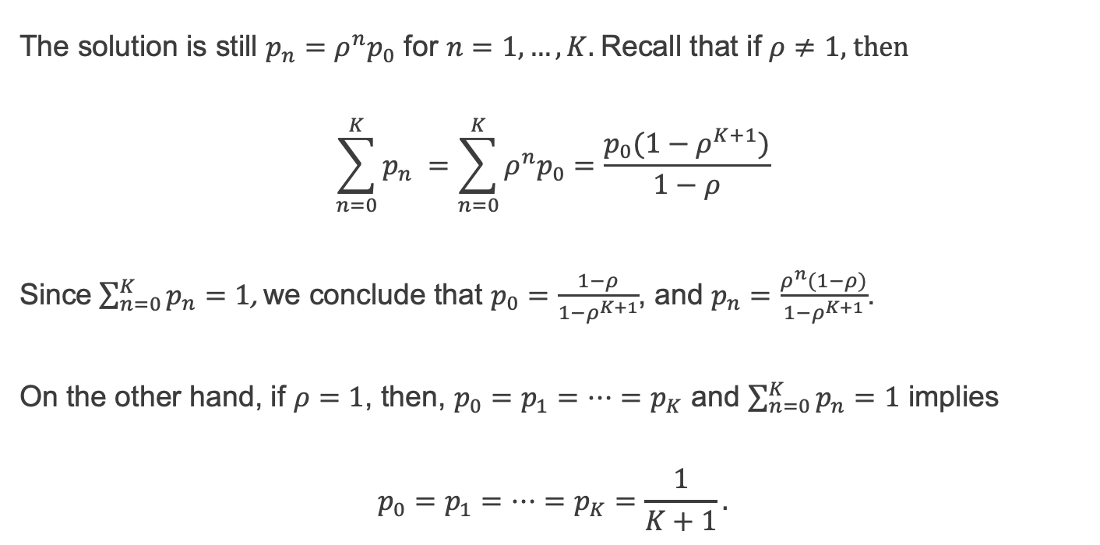
The M/M/1/K model – steady states
The solution is still $p_{n}=ρ^{n}p_{0}$ for $n=1,…,K$. Recall that if $ρ≠1$, then
$$\sum_{n=0}^{K}{p_{n} }=\sum_{n=0}^{K}{ρ^{n}p_{0}}=\frac{p_{0}(1−ρ^{K+1})}{1−ρ}$$
Since $\sum_{n=0}^{K}{p_{n}=1}$, we conclude that $p_{0}=\frac{1−ρ}{1−ρ^{K+1}}$, and $p_{n}=\frac{ρ^{n}(1−ρ)}{1−ρ^{K+1}}$.
On the other hand, if $ρ=1$, then, $p_{0}=p_{1}=…=p_{K}$ and $\sum_{n=0}^{K}{p_{n}=1}$ implies
$$p_{0}=p_{1}=…=p_{K}=\frac{1}{K+1}.$$

Slide 6
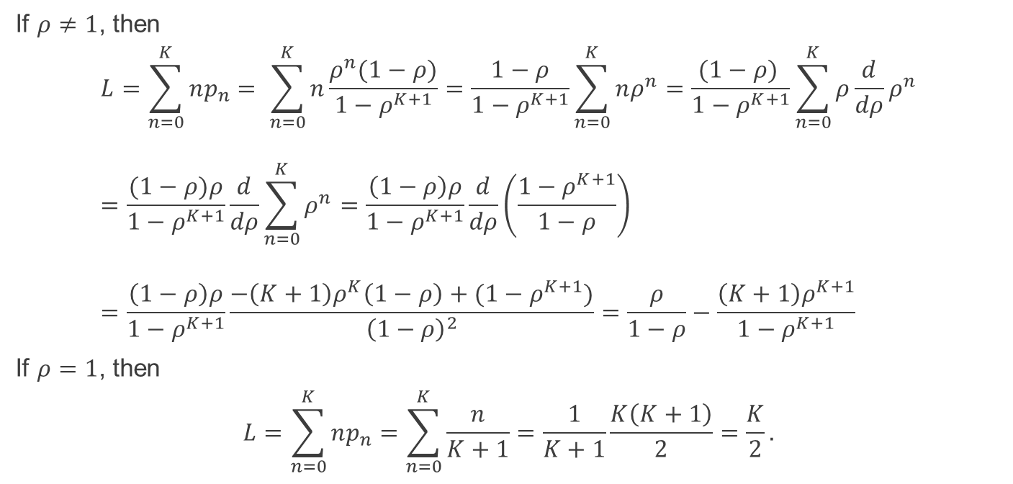
The M/M/1/K model – expected # of customers
If $ρ≠1$, then
$$L=\sum_{n=0}^{K}{np_{n}}= \sum_{n=0}^{K}{n\frac{ρ^{n}(1−ρ)}{1−ρ^{K+1}}}=\frac{1−ρ}{1−ρ^{K+1}}\sum_{n=0}^{K}{nρ^{n}}=\frac{(1−ρ) }{1−ρ^{K+1}}\sum_{n=0}^{K}{ρ\frac{d}{dρ}ρ^{n}} \\ =\frac{(1−ρ)ρ}{1−ρ^{K+1}}\frac{d}{dρ}\sum_{n=0}^{K}{ρ^{n}}=\frac{\left(1−ρ\right)ρ}{1−ρ^{K+1}}\frac{d}{dρ}\left(\frac{1−ρ^{K+1}}{1−ρ}\right) \\ =\frac{\left(1−ρ\right)ρ}{1−ρ^{K+1}}\frac{−{\left(K+1\right)ρ}^{K}\left(1−ρ\right)+(1−ρ^{K+1})}{{\left(1−ρ\right)}^{2}}=\frac{ρ}{1−ρ}−\frac{{\left(K+1\right)ρ}^{K+1}}{1−ρ^{K+1}}$$
If $ρ=1$, then
$$L=\sum_{n=0}^{K}{np_{n}}=\sum_{n=0}^{K}{\frac{n}{K+1}}=\frac{1}{K+1}\frac{K\left(K+1\right)}{2}=\frac{K}{2}.$$

Slide 7
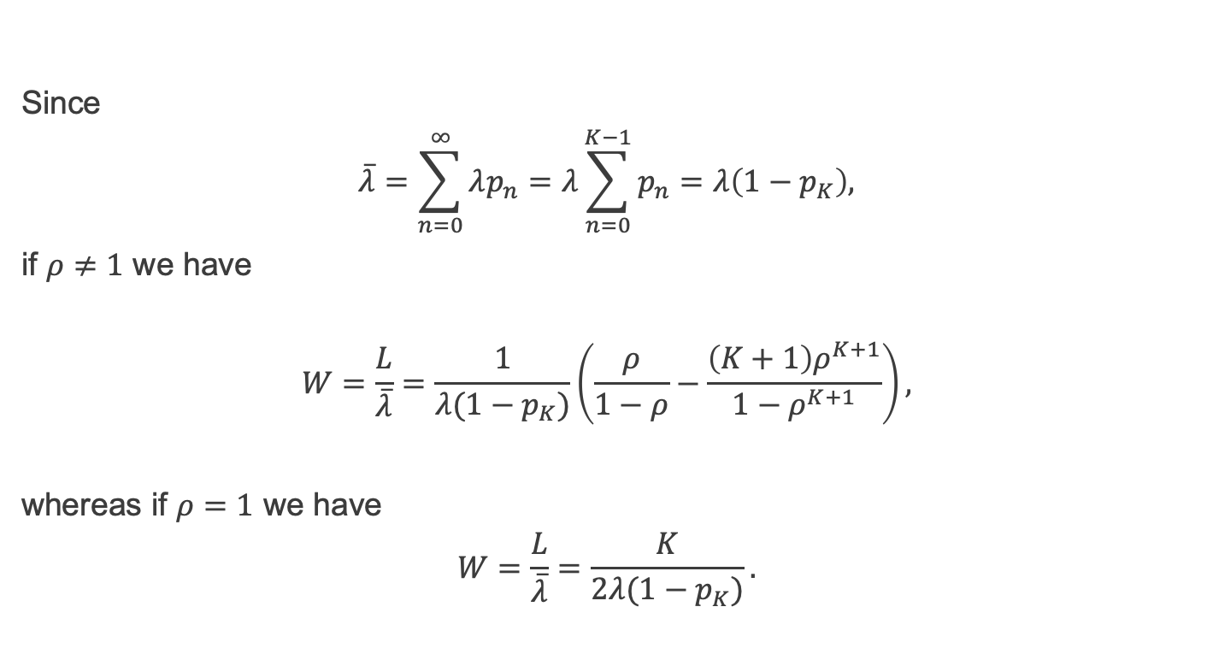
The M/M/1/K model – average stays
Since
$$\overline{λ}=\sum_{n=0}^{∞}{λp_{n}}=λ\sum_{n=0}^{K−1}{p_{n}}=λ\left(1−p_{K}\right),$$
if $ρ≠1$ we have
$$W=\frac{L}{\overline{λ}}=\frac{1}{λ(1−p_{K})}\left(\frac{ρ}{1−ρ}−\frac{{\left(K+1\right)ρ}^{K+1}}{1−ρ^{K+1}}\right),$$
whereas if $ρ=1$ we have
$$W=\frac{L}{\overline{λ}}=\frac{K}{2λ(1−p_{K})}.$$

Slide 8
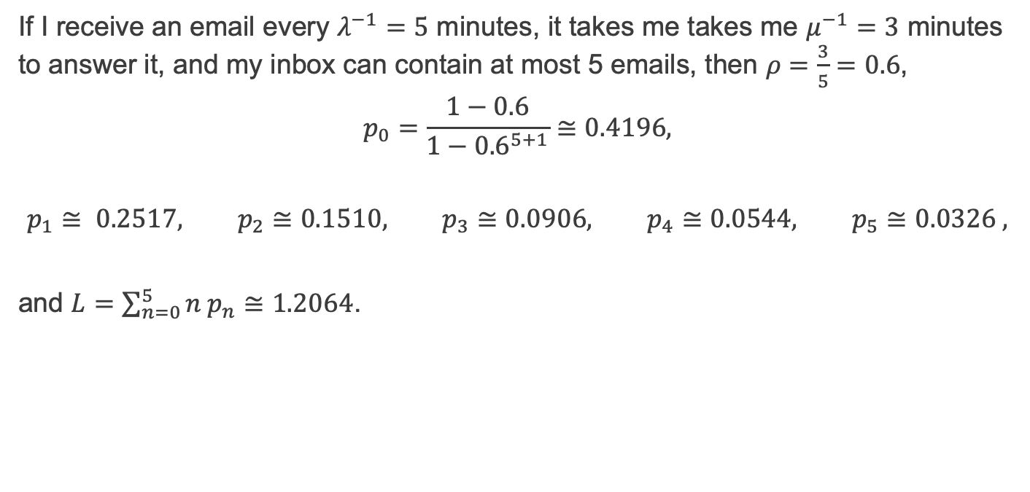
M/M/1 model with finite length - example
If I receive an email every $λ^{−1}=5$ minutes, it takes me takes me $μ^{−1}=3$ minutes to answer it, and my inbox can contain at most 5 emails, then $ρ=\frac{3}{5}=0.6$,
$$p_{0}=\frac{1−0.6}{1−{0.6}^{5+1}}≅0.4196,$$
$$p_{1}≅ 0.2517, p_{2}≅0.1510, p_{3}≅0.0906, p_{4}≅0.0544, p_{5}≅0.0326 ,$$
and $L=\sum_{n=0}^{5}{n p_{n}}≅1.2064$.

Slide 9
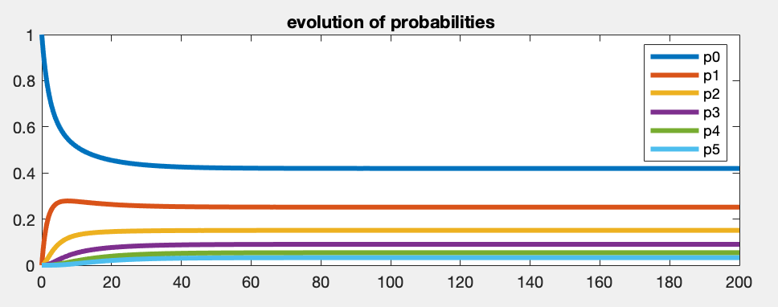

M/M/1/K model – transient behaviour OR_Lect_20_finite_queue.m
For finite length queues, we can also simulate the transient behaviour by solving Kolmogorov's equations using Matlab's ODE suite.
For example, for $K = 5$, using $p( ∙ ,t=0)={\left(1, 0, 0, 0, 0, 0\right)}^{T}$, $λ=5^{−1}$, $μ=3^{−1}$,
and observe that $p\left( ∙ ,t=0\right)≅ (\text{0.}\text{4196}\text{,}\text{0.}\text{2517}\text{,}\text{0.}\text{1511}\text{,}\text{0.}\text{0906}\text{,}\text{0.}\text{0544}\text{,}\text{0.}\text{0326}\text{)}$, which coincides with the steady states computed in the previous slide.

Slide 10
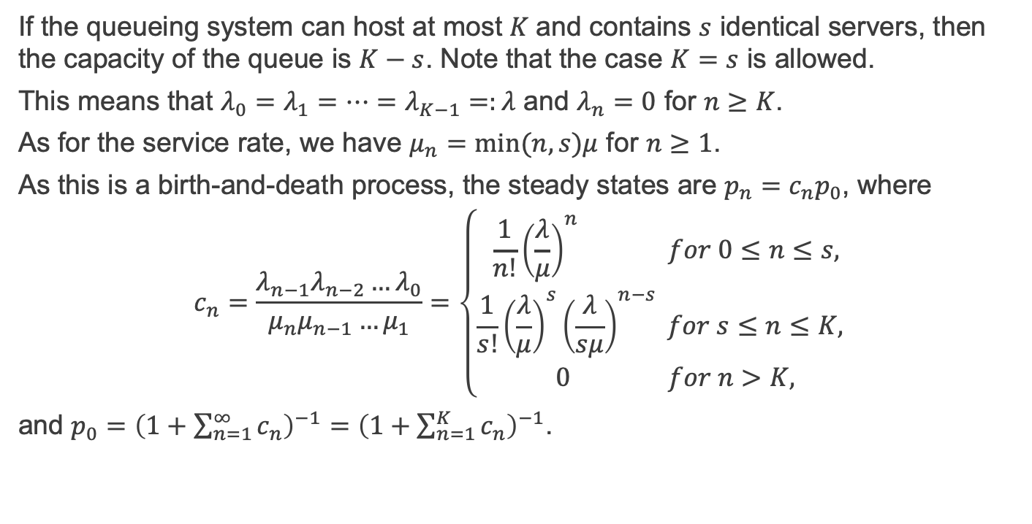
The M/M/s/K model
If the queueing system can host at most $K$and contains $s$ identical servers, then the capacity of the queue is $K−s$. Note that the case $K=s$ is allowed.
This means that $λ_{0}=λ_{1}=…=λ_{K−1}=:λ$ and $λ_{n}=0$ for $n≥K$.
As for the service rate, we have $μ_{n}=min⁡(n,s)μ$ for $n≥1$.
As this is a birth-and-death process, the steady states are $p_{n}=c_{n}p_{0}$, where
$$c_{n}=\frac{{λ_{n−1}λ_{n−2}…λ}_{0}}{μ_{n}μ_{n−1}…μ_{1}}=\left\{\begin{aligned} {\frac{1}{n!}\left(\frac{λ}{μ}\right)}^{n} for 0≤n≤s, \\ {\frac{1}{s!}\left(\frac{λ}{μ}\right)}^{s}{\left(\frac{λ}{sμ}\right)}^{n−s} for s≤n≤K, \\ 0 for n>K, \end{aligned}\right.$$
and $p_{0}={\left(1+\sum_{n=1}^{∞}{c_{n}}\right)}^{−1}=$ ${\left(1+\sum_{n=1}^{K}{c_{n}}\right)}^{−1}$.

Slide 11
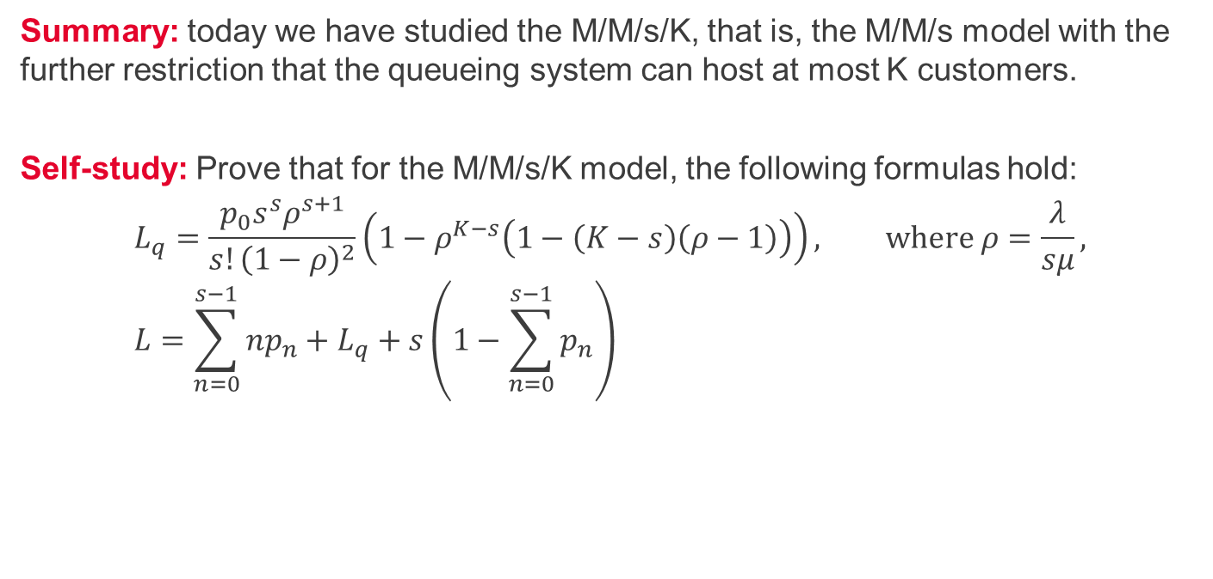
Summary and self-study
Summary: today we have studied the M/M/s/K, that is, the M/M/s model with the further restriction that the queueing system can host at most K customers.
Self-study: Prove that for the M/M/s/K model, the following formulas hold:
$$L_{q}=\frac{p_{0}s^{s}ρ^{s+1}}{s!{\left(1−ρ\right)}^{2}}\left(1−ρ^{K−s}\left(1−\left(K−s\right)\left(ρ−1\right)\right)\right), where ρ=\frac{λ}{sμ}, \\ L=\sum_{n=0}^{s−1}{np_{n}}+L_{q}+s\left(1−\sum_{n=0}^{s−1}{p_{n}}\right)$$

